Slide 1
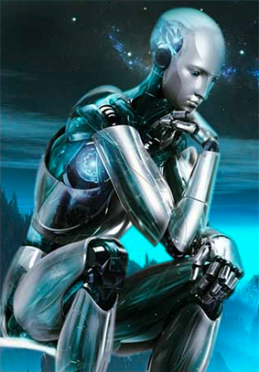
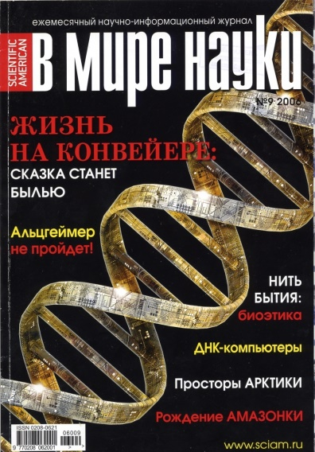
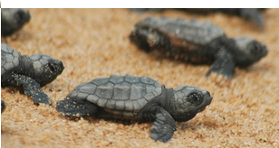
MATRIX GENETICS, WALSH FUNCTIONS, INHERITED PROCESSES AND ARTIFICIAL INTELLECT 矩阵遗传学， WALSH函数，继承与进程及人工智能 S.V. Petoukhov Russian Academy of Sciences, Moscow 俄罗斯科学院，莫斯科 http://petoukhov.com/

Slide 2
Science has led to a new understanding of life itself: «Life is a partnership between genes and mathematics» [ Stewart I. Life‘s other secret: The new mathematics of the living world. 1999, N.-Y.]. But what mathematics can be a partner of genes? The author studies this question by means of mathematics of matrices (“matrix genetics”), taking into account the following.
科学引起对生活本身的新认识：«生活是基因和数学之间的伙伴关系»[Stewart I. ，生命中的另一秘诀：新生活世界的数学。 1999年，N.-Y.。
但是什么样的数学可以成为基因的伙伴呢。笔者通过数学方法矩阵（“矩阵遗传学”）的方式进行研究。

Slide 3
Information from the micro-world of genetic molecules dictates constructions in the macro-world of living organisms under strong noise and interference. This dictation is realized by means of unknown algorithms of multi-channel noise-immunity coding. For example, in accordance with Mendel‘s laws of independent inheritance of traits, colors of human skin, eye and hairs are genetically defined independently. So, each living organism is an algorithmic machine of multi-channel noise-immunity coding. To understand this machine we should use the theory of noise-immunity coding, which is based on matrix representations of digital information. Correspondingly we search mathematics of genetic systems in matrix representations of ensembles of genetic elements.
微观世界的遗传分子信息决定宏观世界生物体在强噪声和干扰下的构造。这是通过一种不知名的多通道抗噪声干扰编码的算法实现。 例如根据孟德尔独立遗传定律，人类的皮肤，眼睛以及头发的颜色都是由基因独立决定的。每一个生命体都具有一个多通道抗干扰算法的机制。为了理解这个机器，我们应使用抗干扰编码理论，它是基于数字信息矩阵表示。与此相对应，我们在遗传元素组成的矩阵表示中寻找一种数学的遗传系统。

Slide 4
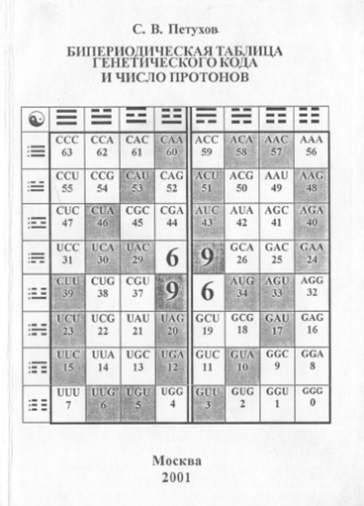
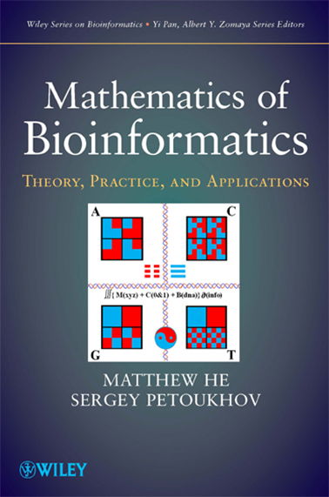
This presentation on “matrix genetics” is based on author’s publications shown on his website http://petoukhov.com/ including the following books published in Russia and USA:
本次介绍的矩阵遗传学在他的网站上是可以找到，包含以下几本俄罗斯与美国出版的刊物。

Slide 5
Molecules of heredity - DNA and RNA – contain sequences of 4 “letters” or nitrogenous bases: adenine (A), cytosine (C), guanine (G), thymine (T) (or uracil U in RNA). 64 triplets (or all possible combinations of three genetic letters: AAC, GCT, …..) encode 20 amino acids (and punctuation signs), a sequence of which forms a primary structure of proteins. The genetic code of amino acids is called “degenerate code” since 64 triplets encode 20 amino acids.
遗传分子DNA与RNA，其中包含四个字母或者说氨基酸序列分别为;：DNA和RNA- - 遗传的分子中含有4个“字母”或含氮碱基序列：腺嘌呤（A），胞嘧啶（C），鸟嘌呤（G），胸腺嘧啶（T）（或尿嘧啶中的U RNA”。64三联体（或三种基因字母所有可能的组合：AAC，GCT，.....）。它们编码了20种氨基酸，构成了蛋白质的原始结构顺序。

Slide 6
Letters C-G and A-T/U form complementary pairs with 3 and 2 hydrogen bonds.
字母C-G与A-T/U 与3到2个氢键形成互补对

Slide 7
In noise-immunity coding and quantum mechanics, Hadamard matrices, rows of which are Walsh functions, play significant roles. By definition, a Hadamard matrix is a square matrix H with entries ±1, which satisfies H*H^{T} = n*E, where H^{T} - transposed matrix, E – identity matrix. Tensor (or Kronecker) exponentiation of Hadamard (2*2)-matrix H₂ generates a tensor family of Hadamard (2^{n}*2^{n})-matrices H₂^{(n)}
(black cells correspond to components “+1”, white cells – to “-1”; number in brackets (n) means a tensor power).
在抗干扰度编码和量子力学, Hadamard矩阵, ,扮演重要的角色，其中主要的是Walsh函数。根据定义,一个Hadamard是一个方阵H可以键入±1 ,满足H * HT = n * E,HT -转置矩阵,E -单位矩阵。张量Hadamard (2 * 2)矩阵的求幂H2生成一个张量的阿达玛(2 n * 2 n)矩阵H2(n): n.KBlack细胞对应组件“+ 1”,白细胞——“1”。数字在括号中(n)意味着一个张量n次方。

Slide 8
Here one can remind that tensor (or Kronecker) multiplication of matrices is a known operation in mathematics, physics and informatics:
提示：张量矩阵乘法是数学,物理学和信息学中一种众所周知的操作。

Slide 9
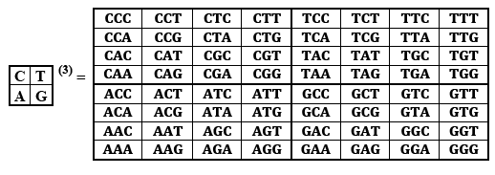
用类推的方法,我们研究符号矩阵的张量族(C;T G)(n)的DNA-字母A,C、G、T (腺嘌呤、胞嘧啶、鸟嘌呤、胸腺嘧啶)。
这里的矩阵(C;T G)(3)包含 64密码子的强大顺序。
我们将会展示这些由64三元体构造构成的矩阵与特异性遗传密码简并以及中国古书《易经》中的64卦有着意想不到的联系，
By analogy we study the tensor family of symbolic matrices [C T; A G]^{(n)} of the DNA-alphabet A, C, G, T (adenine, cytosine, guanine, thymine). Here the matrix [C T; A G]⁽³⁾ contains the complete set of 64 triplets in a strong order. We will show that this formally constructed matrix of 64 triplets has unexpected connections with a specificity of the degeneracy of the genetic code and with the famous table of 64 hexagrams of the Ancient Chinese book “I-Ching”.

Slide 10
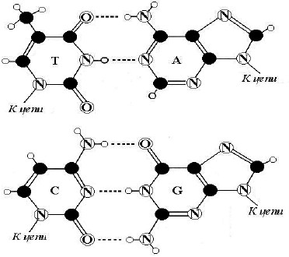
The 4-letter alphabet of nitrogenous bases A, C, G, T/U bears the symmetric system of 3 kinds of binary-oppositional attributes, which divide this alphabet into various three pairs of attributive-identical letters denoted by 0 or 1 in each kind. In other words, 3 binary sub-alphabets exist in this 4-letter alphabet:
含氮碱基的4个字母A，C，G，T/ U承担其对称系统多组相反的属性。可以将这些字母分成很多种3对的具有实质意义的属性。(遗传系统密切相关的二进制数字)。

Slide 11
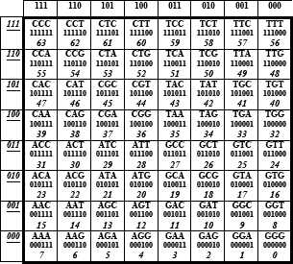
Due to these binary sub-alphabets, one can read columns of the genetic matrices from the standpoint of the first sub-alphabet, and the rows – from the second sub-alphabet. In this case each of triplets gets its individual 6-digit binary number, where the first 3 positions reproduce the numeration of its row, and the second 3 positions – the numeration of its column.
由于这些二进制字母表可以从第一个字母表读取第一个列矩阵，从第二个字母表读取列矩阵。在这种情况下,每个三元体由6位二进制数组成,第前三位复制记为行,后三位作为它的列。

Slide 12
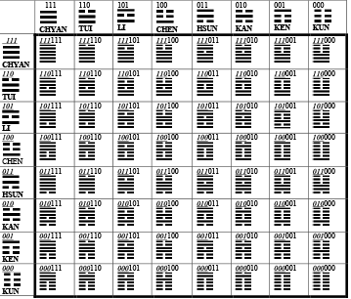
The received numerated matrix of 64 triplets coincides with the famous table of 64 hexagrams in the Fu-Xi’s order from the Ancient Chinese book “I-Ching” written a few thousand years ago (solid lines of hexagrams = 1, broken lines = 0). The ancient Chinese claimed that this table is the universal archetype of nature. They knew nothing about the genetic code, but the genetic code is constructed in accordance with the ”I-Ching” in many aspects.
这为数64个三元体巧遇中国几千年前《易经》上的64卦（线卦= 1,破行= 0。中国古代称,这个表是宇宙的自然的原型。他们对遗传密码一无所知,但遗传密码的构造却是在许多方面按照“易经”而来 。

Slide 13
Each of 64 hexagrams consists of trigrams numerating its row and its column (by analogy with the matrix of 64 triplets) and which are identical to binary numbers.
G.Leibniz, who considered himself a creator of binary numbers, was amazed to learn that the Chinese have known them for thousands of years before him.
64卦中的每一个都是行和列的矩阵(通过类比64密码子), 与二进制数字相同。 G.Leibniz认为自己是二进制数字的创立者，惊讶的发现中国早在他之前的数千年已经知道。

Slide 14
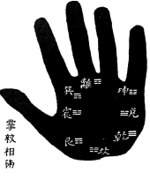
Traditional Oriental medicine and many aspects of life in Oriental countries were based on systems of “I-Ching”. Confucius said: “If it would be possible to extend my years, I would have given fifty of them for study of ”I-Ching“. According to the creator of analytical psychology C. Jung, trigrams and hexagrams of “I-Ching” “fix a universal set of archetypes (innate psychic structures)”. Niels Bohr has chosen the symbol Yin-Yang as his personal emblem.
东方传统医学和生活的许多方面都基于《易经》，孔子说:“如果有可能延长我的年岁的化,我将会花50年的时间来研究《易经》.
根据C. Jung分析心理学的创始人，三元模型和《易经》的卦设定一套通用的原型， Niels Bohr 已经选择阴和阳作为个人的象征。
.

Slide 15
Additional analogies between genetic system and “I-Ching”: 易经与基因系统的其他对比
Molecular-genetic system | I-Ching
4 nitrogenous bases A, C, G, T have a basic meaning:含氮碱基A、C、G、T | 4 digrams have a basic meaning: Old Yang ( ), Old Yin ( ), Young Yang ( ) and Young Yin ( ).
The third tensor power of the genetic matrix leads to the matrix of 64 triplets. 第三个产生基因矩阵生成64个三元体 | The third tensor power of the matrix ⁽³⁾ leads to the table of 64 hexagrams of Fu-Xi’s order. 第三个矩阵导致64卦的顺序
2 and 3 hydrogen bonds connect complementary DNA-letters A-T and C-G. 2和3氢键连接互补DNA碱基A-T 与C-G | Numbers 2 and 3 were fundamentals of ancient Chinese arithmetic. 2和3是中国古代算术的基础

Slide 16
Logical operations, dyadic groups and artificial intellect
Engineers try to reproduce inherited intellectual abilities of biological bodies in digital devices of artificial intellect. But for understanding and mathematical modeling of intellectual properties, an appeal to the algebra of logic is a necessary step! “Without mathematical logic the debate, which are so fashionable today, about whether a machine can think, lose any grounds, and the urgent problem of creating artificial intelligence becomes meaningless” (I.M.Yaglom “Boolean structure and its models”, Moscow, 1980 We have revealed evidences of a deep relation of genetic systems with Boolean algebra of logic.
逻辑运算,二元组和人工智能
工程师们尝试着利用人工智能电子设备来复制生物体的遗传智力。但是为理解数学模型的知识产权，上溯到代数逻辑也是非常有必要的。 如今数学逻辑盛行，假想如果没有数学逻辑的辩论，也就是关于机器能否思考就就失去了任何理由，那么亟待解决的人工只能就变得没有任何意义了。（我们已发现遗传系统与布尔代数之间深刻的逻辑关系。 ）

Slide 17
The fundamental logic operation is modulo-2 addition.
By definition, the modulo-2 addition of two binary numbers is made in a bitwise manner in accordance with the following rules: 0⊕0 = 0, 0⊕1 = 1⊕0 = 1, 1⊕1 = 0. By means of modulo-2 addition, binary n-digit numbers form so called dyadic groups. For example, the set of binary 3-digit numbers 000, 001, 010, 011, 100, 101, 110, 111 forms the dyadic group, in which modulo-2 addition serves as the group operation (this addition of any two members of dyadic group gives a member from the same group; for example 011⊕110=101).
基本逻辑运算是模2加法。
根据定义,两个二进制数的模2加法依据以下规则:0⊕0 = 0,0⊕1 = 1⊕0 = 1,⊕1 = 0。 通过模2加、二进制n位数字形成所谓的二元组。例如,一组二进制三位数的数字000,001,010,011,100,101,110,111形成二元组,模2除作为一组操作(modulo-2 任意两个模2的二元组的成员从同一组给出一个成员到另一个组;例如011⊕110 = 011

Slide 18
The quantity of members in the dyadic group of 2n-digit binary numbers is equal to 2^{2n}. But precisely these quantities 2^{2n} of members are contained in DNA-alphabets of n-plets (monoplets, doublets, triplets, etc.):
- 2^{2*1} = 4 members in the alphabet of monoplets
(nitrogenous bases A, C, G, T);
2^{2*2} = 16 members in the alphabet of doublets
(AA, AC, AG, ....);
2^{2*3} = 64 members in the alphabet of triplets
(AAA, AAC, ACA, . . . );
Dyadic groups are closely connected with complete orthogonal groups of Walsh functions, which are mathematical characters of dyadic groups [Fine, 1949].
例如,二元组的成员的数量2 n位二进制数等于2^{2n}。
这些成员的2^{2n}都是包含在DNA字母表的n-plets 中（单元组。双元组。三元组），
22*1 = 4 字母表的成员(含氮碱基A、C、G、T)
- 22*2 = 16 字母表的成员(AA,AC,AG)
- 22*3 = 64字母表的成员(AAA, AAC, ACA, . . . )
二元组与完整的Walsh 函数正交组织密切联系，数学特征的二元组。

Slide 19
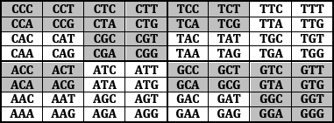
Walsh functions in the genetic matrix of 64 triplets
As known, the set of 64 triplets is divided by Nature into two equal subsets of 32 triplets with “strong roots” (black colors) and 32 triplets with “weak roots” (white colors). The term “root” means letters on the first two positions in each triplet. The code meanings of triplets with strong roots are independent from letters on their third position.
函数的基因矩阵的64元组
众所周知，64三元组集被自然地分成2个相等的子集，其中有32个三元组是“强根源”（黑底的），另外32个三元组是“弱根源”（白底的）。

Slide 20
The schemes of degeneracy for the Standard Code and the Vertebrate Mitochondrial Code with 32 “black” triplets and 32 “white” triplets. Yellow color marks the white triplets with other code meanings relative to the Standard Code.
该计划中有Standard 编码 与Vertebrate Mitochondrial 编码，其中带有32黑色三元组，32个白色三元组。其中黄色表示的是白色三元组与其他编码意义相关的标准编码。

Slide 21
The unexpected phenomenological fact is a symmetrical disposition of black triplets and white triplets in the genomatrix [C T; A G]⁽³⁾, which was constructed formally without any mention about strong and weak roots, amino acids and about the degeneracy of the genetic code:

Slide 22
Symmetrical properties of the genomatrix:
1) The left and right halves of the matrix mosaic are mirror-anti-symmetric each to other in its colors: any pair of cells, disposed by mirror-symmetrical manner in the halves, possesses the opposite colors;
2) both quadrants along each diagonals are identical from the viewpoint of their mosaic。
基因矩阵[C, A; T, G]⁽³ 对称属性
1) 左右两部分的矩阵拼合是互相反对称的，任何一个单元，都是相对另外一部分反对称的，具有相反的颜色。
2) 从拼合的角度来说，每个象限沿着对角线是相同的。

Slide 23
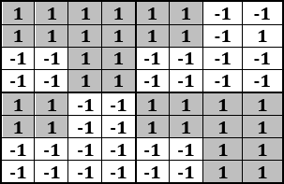
3) Mosaics of all columns have a meander-line character, which is identical to some of Walsh functions. It should be noted that a huge quantity 64! ≈ 10⁸⁹ of variants exists for dispositions of 64 triplets in the (8*8)-matrix. For comparison, the modern physics estimates time of existence of the Universe in 10¹⁷ seconds. It is obvious that an accidental disposition
of the 20 amino acids and the corresponding triplets in a (8*8)-matrix will give almost never any symmetry. But in genetics we have wonderful symmetries in the location of black and white triplets.
3) 拼合的所有的行都有一个曲折线，这个和Walsh函数是有些相同的。
需要注意64! ≈ 1089，这样一个巨大数量的变异将放生在一个(8*8)-的矩阵中的64的三元组中。相比之下,现代物理学估计宇宙的存在时间为10¹⁷秒。显然，一个偶然组成的20种氨基酸以及在相应的(8*8)三元矩阵中将不会给出任何的对称。

Slide 24
可以以矩阵P_{MUSIC}^{(n）} 每一个基因矩阵P_{MULT}^{(n}的形式表在基因矩阵中可能出现的另一个Walsh 函数 DNA字母A, C, G, T, 中胸腺嘧啶T与其他三个字母相比有着独特的地位。
1) 在DNA向RNA转换中只有胸腺嘧啶T可以被其他的分子U(尿嘧啶)所取代。
2) 只有胸腺嘧啶T没有重要氨基酸氨基。这里的二进制的位置可以用A=C=G= +1, T= -1.表达
所有的三元组的字母都可以用这些数字进行替换，用数字的形式表达三元组。 示音符的频率（“音乐矩阵”）。
Another appearance of Walsh functions in the genomatrix
Inside the DNA-alphabet A, C, G, T, thymine T has a unique status and differs from other three letters:
1) only thymine T is replaced by another molecule U(uracil) in transferring from DNA to RNA;
2) only thymine T hasn’t the functionally important amino group NH₂.
This binary opposition can be expressed as: A=C=G= +1, T= -1. Correspondingly in each triplet all its letters can be replaced to these numbers to represent numerically the triplet as the product of these numbers.

Slide 25
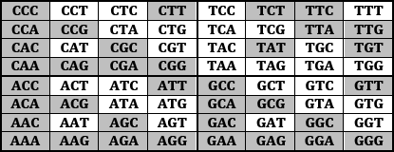
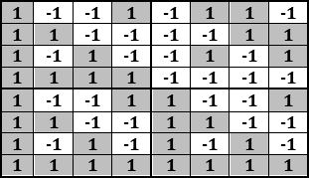
In the result, the genetic matrix [C, T; A, G]⁽³⁾ of 64 triplets gets its numeric representation, which coincides with the complete orthogonal system of Walsh functions for
8-dimensional space.
基因矩阵64个三元组的[C, T; A, G](3)用数字的形式表达，这个正好就是Walsh 函数的8维空间的完整的正交系统

Slide 26
Such complete systems of Walsh functions are used in noise-immunity coding of information, for example, on the spacecrafts “Mariner” and “Voyager”, which transmit to Earth pictures of Mars, Jupiter, Saturn, Uranus and Neptune. Complete systems of Walsh functions form Hadamard matrices, which are used in quantum computers (“Hadamard gates”) and in quantum mechanics as its unitary operators. In our approach, the complete orthogonal system of 8 Walsh functions represents the genetic alphabet of 64 triplets (in a connection with “I-Ching”).
Walsh 函数的完整系统被用于抗干扰度信息编码中 将火星,木星,土星,天王星和海王星的图片传到地球上。 Walsh 函数中完整的系统形成Hadamard 矩阵，用于量子计算机(“阿达玛门”),在量子力学中作为一种唯一的操作方法。
在我们的方法中8 Walsh 的完整的正交系统代表基因组的64位三元组，（与中国的《易经》相联系）

Slide 27
If one of the Chinese digrams is taken to be opposite to other 3 digrams (for example, is denoted “-1”, and others = “+1”), then the Ancient Chinese Table of 64 hexagrams is transformed into a Hadamard matrix H₈ with Walsh functions ( H₈*H₈^{T} = 8*E) (taking into account the Chinese principle of correlative positions in hexagrams - 1-4, 2-5, 3-6 – and replacing each hexagram by the product of its 3 digrams in such representation). So “I Ching” is related also with Walsh functions and Hadamard matrices in these ancient tables of archetypes of the Nature.
如果中国双字母组合之一被取为相对于其他3双字母组合（例如，被表示为“-1”，和其他=“+ 1”），则64个卦古代中国表变换成一个Hadamard矩阵H8在其Walsh函数行中（H8* H8T= 8* E）:
(考虑到相关职位的中国原则卦 - 1-4，2-5，3-6 - 并通过其3双字母组合的乘积来替换各个卦在这样的表示）。所以，“易经”也是一个与 Walsh 函数和有关，关于大自然中古老表格的Hadamard矩阵的原型。

Slide 28
Hadamard matrices, which are related with genetic informatics, possess many interesting mathematical properties. Let us mention some of them beginning with projection operators and cyclic groups of transformations on their bases.
与遗传信息相关的Hadamard矩阵，具有许多与数学相关的有趣的属性。让我们从他们的基础：投影算子和循环群的变换开始。

Slide 29
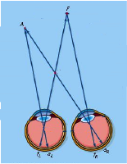
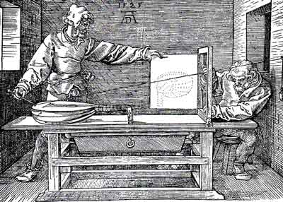
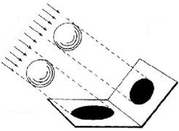
Hadamard matrices and projection operators
Our visual perception and a “projection method” in
the drawing are based on projections of external objects on retina and a drawing plane. In mathematics, such operations of projections are expressed by means of square matrices, which are called “projection operators” (or “projectors”).
Hadamard矩阵和投影算子
我们在图纸上的视觉感知和“投影方法”都是基于视网膜上的外部物体和绘图平面的投影。在数学中通过平方矩阵表示操作预测，被称为“投影算子”(或“投影仪”)。

Slide 30
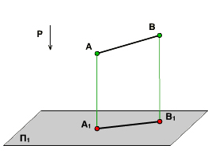
A necessary and sufficient condition that a matrix P is a projection operator is given by the criterion:
P² = P.
The following matrix P is an example of a projector, which makes a projection of vector [x, y, z] on the plane [x, y, 0].
Let us show that the genetic Hadamard matrix H₈ is a sum of 8 projectors.
条件矩阵P是一个基于P2 = P的投影算子让我们呈现Hadamard 矩阵H8使用8个算子。
下面的矩阵P例子，是一个算子，可以让投影向量[x, y, z]出现在平面[x, y, 0]上

Slide 31
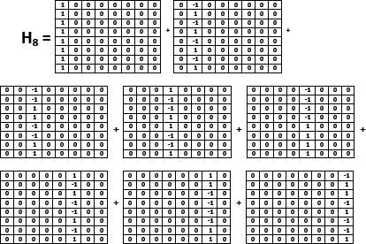
The matrix H₈ is a sum of 8 sparse matrices, in which only one of columns is non-zero (each of non-zero-columns coincides with one of Walsh functions): H₈=p₀+p₁+p₂+p₃+p₄+p₅+p₆+p₇, where each of p_{i} is a projector operator since p_{i}² = p_{i}. These “genetic” projectors allow modeling genetically inherited bio-ensembles.
矩阵H8是一个系数矩阵，只有一列不是0（每一个不是0的列刚好就是一个Walsh函数）
这些基因算子允许基因 遗传生物合奏。

Slide 32
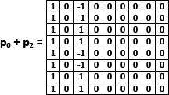
INHERITED ENSEMBLES OF BIOLOGICAL CYCLES Any living organism is a huge ensemble of inherited cyclic processes, which form a hierarchy at different levels. It is known that mathematical cyclic groups are useful to model natural cyclic processes. But combinations of the considered genetic projectors (and their generalizations) lead to a great number of cyclic groups. For example, let us take the sum of 2 projectors p₀ and p₂.
Exponentiation (2^{-0.5}*(p₀+p₂))^{N} gives a cyclic group with its period 8: (2^{-0.5}*(p₀+p₂))^{N} = (2^{-0.5}*(p₀+p₂))^{N+8} (here N=1, 2, 3, …).
生物周期的遗传集合
任何生物都是一个巨大的继承集合，它在不同层次上形成层次结构。数学循环组对模型自然循环过程是非常有用的。但考虑遗传投影的组合会导致大量的循环组。

Slide 33
Iterative actions of this operator Y = 2^{-0.5}*(p₀+p₂) on an arbitrary 8-dimensional vector X=[x₀, x₁, x₂, x₃, x₄, x₅, x₆, x₇] give a cyclic set of 8 vectors, in which only two coordinates with appropriate indexes 0 and 2 are changed cyclically, all other coordinates are equal to 0. It means that such operators give us the ability of a selective manage of cyclic processes in separate sub-spaces of multi-dimensional spaces (or in separate sub-systems of multi-parametric systems), for example, to model different animal gaits. The simplest example of this type is our model of human gaits, where cyclic movements of separate hands and foots can be defined independently:
操作符y = Y = 2^{-0.5}*(p₀+p₂迭代任意一个8维向量x = [ X0，X1，X2，X3，X4、X5、X6、X7 ]得到一个循环的8个向量集合。坐标0和2是循环变化的，其他所有的坐标都等于0。这意味着这些算子给我们在多维空间中选择独立的子空间的循环过程的能力（或多参数系统的单独子系统）。这一类型中最简单的例子就是我们人类的步态模式，手与脚循环运动是可以单独定义的。

Slide 34
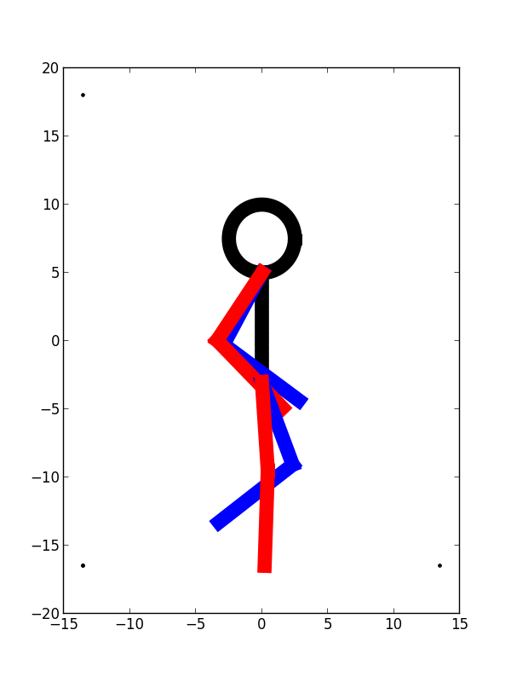
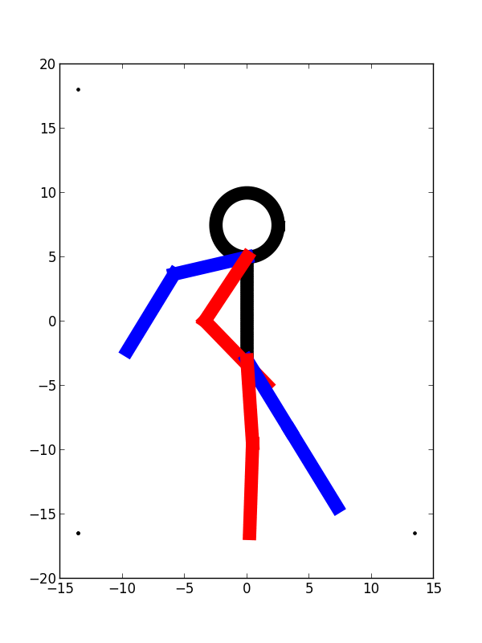
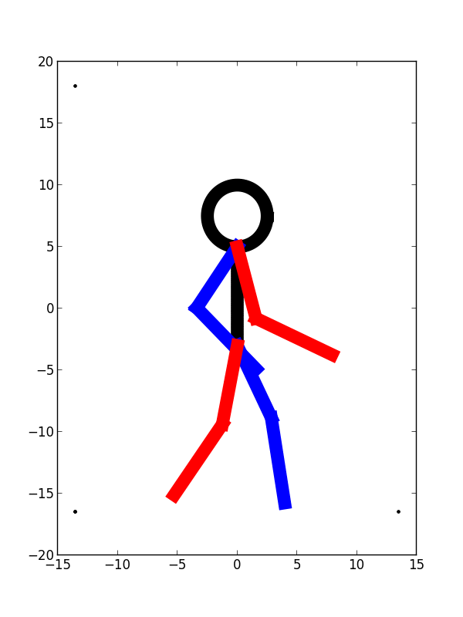
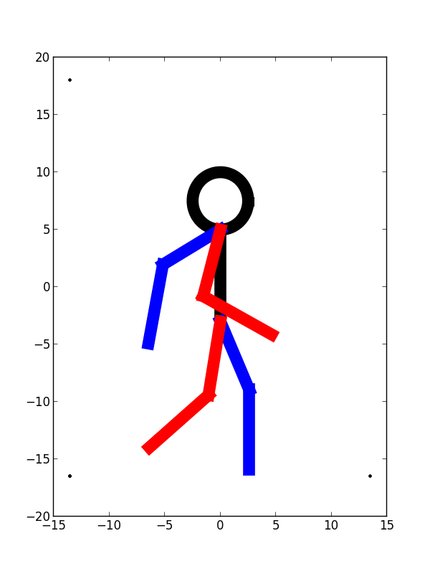

Slide 35
But what one can do if big ensembles with thousands and more cyclic processes should be simulated? A proposed decision is based on extensions of the Hadamard (8*8)-matrices H₈ into (2^{N}*2^{N})-matrices by the following expressions: H₈  [1 -1; 1 1]^{(N)} , where  means tensor multiplication; (N) – tensor power, N = 1, 2, 3, … . Each of these (2^{N}*2^{N})-matrices are sums of 2^{N} projectors of the same “Walsh type”. Exponentiation of sums of different pairs of these new projectors gives as much cyclic groups as you want. These cyclic groups possess the same property of a selective control of 2-parametric subsystems inside 2^{N}-parametric systems. The revealed matrix approach gives new opportunities not only for studying inherited biological phenomena but also for biotechnical applications including systems of artificial intellect and robotics.
但是如果成千上万的循环过程合在一起那么我们可以做什么？该提议的决定是基于扩展的Hadamard (8*8)矩阵H(8)转换为(2^{N}*2^{N})矩阵，通过以下表达方式： H₈  [1 -1; 1 1]^{(N)，}其中意味着张量乘法； (N)张量功率， N = 1, 2, 3, … . 每一个（2^{N}*2^{N})矩阵都是2^{N} 算子的和。计算不同算子对的总和后取幂，得到尽可能多的循环群。这些循环群具有选择控制系统内2维参数系统的相同属性。该矩阵方法无论是研究遗传生物现象还是生物技术的应用，包括人工智能和机器人系统，都提供了新的机会。

Slide 36
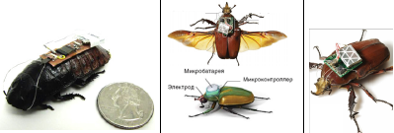
More deep analysis of sums of “genetic” projectors related with Walsh functions has led us to operators, which can be used for a selective manage of non-cyclic processes in subsystems of multi-parametric systems, for example, in the case of a group of cockroaches, movements of each of which are controlled remotely by radio. (In the United States such equipment for cockroach is sold freely on the market for $ 100). Groups of these cyborgs are used to search for people in buildings destroyed by earthquake, etc.
更深入分析与Walsh函数相关的基因投影，它可以用于多参数系统的子系统中的非循环过程的选择性管理。例如，一组蟑螂，每一个都可以通过无线电遥控运动。（在美国，这种蟑螂设备在市场上卖100美元）。这些机器是用来寻找地震后人员搜救，等等。

Slide 37
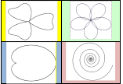
Let us imagine that we have an 8-parametric system in a form of a group of such 4 cockroaches, each of which should move along a certain trajectory in a 2-dimensional plane. Such group of cockroaches can be represented as a set of four points, each of which moves in a plane along its 2-parametric curve, for example, of the following kinds:
让我们假设我们有一个8-维参数系统中有一组4只蟑螂，分别在二维平面上应沿着一定的轨迹移动。蟑螂群可以表示为四个点，每一个动作都是一个平面的2维参数曲线，如下：

Slide 38
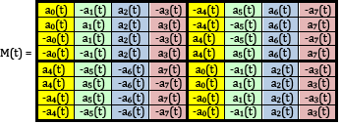
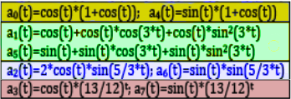
This task is solved by the following matrix operator with 8 components
a₀(t), a₁(t), ..., a₇(t):
Movements of 4 cockroaches along these trajectories are implemented by the following expressions of components:
该任务由矩阵操作分成8个部分
沿着轨迹运动的4只蟑螂以下4个表达部分。

Slide 40
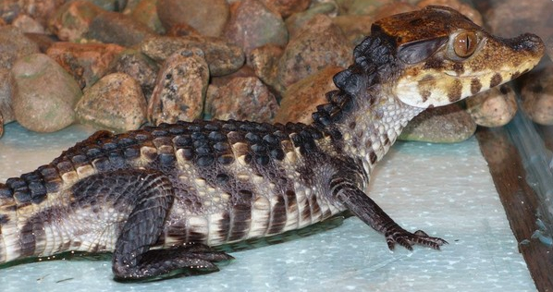
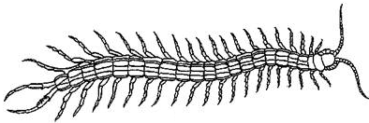
INHERITED PROCESSES AND
BOOLEAN ALGEBRA OF LOGIC
What mathematics can be a partner of genes to provide inherited algorithmic processes including algorithms of proceeding of sensory information and algorithms of motion control?
继承过程和逻辑布尔代数
数学如何成为基因的合作伙伴，以提供继承算法过程，包括算法的感觉信息和算法的运动控制？

Slide 41
For example, newborn turtles and crocodiles, when they hatched from eggs, crawl with quite coordinated movements to water without any training from anybody. Celled organisms, which have no nervous systems and muscles, move themselves by means of perfectly coordinated motions of cilia on their surfaces (the genetically inherited “dances of cilia”). The cilia “dance” in the celled organism (Opalina ranarum}
细胞生物的纤毛“舞蹈”
例如，新生的海龟和鳄鱼，自它们从蛋中孵化，没有任何人的训练，却可以在水中动作协调的爬行。没有神经系统和肌肉的细胞生物，完美的协调运动，因为其表面的纤毛（遗传性“舞蹈纤毛”
For example, newborn turtles and crocodiles, when they hatched from eggs, crawl with quite coordinated movements to water without any training from anybody. Celled organisms, which have no nervous systems and muscles, move themselves by means of perfectly coordinated motions of cilia on their surfaces (the genetically inherited “dances of cilia”):
The cilia “dance” in the celled organism (Opalina ranarum}

Slide 42
It is obvious that the known genetic code of protein sequences of amino acids can’t explain these inherited algorithmic motions, in which a great quantity of muscle units, nerve cells, etc. are working in a coordinated way like parts of a computer.
Computers are based on networks of two-positional switches (triggers), each of which can be in one of two states: “yes” or “no”. But in physiology, the “trigger-type” law “all-or-none” for excitable tissues is known: a nerve cell or a muscle fiber give only their answers “yes” or “no” under action of different stimulus by analogy with Boolean variables. For stimulus of sub-threshold values, a nerve or a muscle fiber give no response; for supra-threshold values of stimulus they give responses of their maximal amplitude.
很明显，蛋白质中的氨基酸序列不能解释这些遗传算法运动。就像计算机一样，其中大量的肌肉单位，神经细胞等都处于协调的工作当中。
计算机是基于触发器的网络，都是：“是”或“否”两种状态。在生理学中兴奋组织触发器规则是“全或者无”。在不同刺激的作用下，通过类比布尔变量，一个神经细胞或肌纤维只给“是”或“否”，对亚阈值的刺激， 神经或肌肉纤维没有响应；为刺激他们给振幅响应阈上值。

Slide 43
R. Penrose [“Shadows of the Mind”, 1996] - in his thoughts about biological quantum computers - appeals to the known fact that tubulin proteins exist in two different configurations, and they can switch between these configurations like triggers to provide bio-computer functions. All these known facts testify that a living organism can be interpreted as a genetically inherited huge network of triggers of different types, which should be related with systems of Boolean functions and binary numbers. We have shown above that molecular-genetic systems are also deeply related with binary numbers, their dyadic groups, logic modulo-2 addition and Walsh functions.
R. Penrose [“头脑的阴影”，1996 ]中他关于生物量子计算机的想法，呼吁了解微管蛋白蛋白存在于两个不同的配置的事实。他们可在配置之间切换，如触发器，提供生物计算机功能。已知的事实证明，活的有机体可解释巨大遗传网络不同类型的触发器，这应与布尔函数和二进制数字系统有关。我们上面所说的分子遗传系统也与二进制数密切相关，二进组，逻辑模2加法以及沃尔什函数。

Slide 44
Taking these known facts into account, we propose to consider a living organism as a genetically inherited huge network of triggers of different types and different biological levels, including trigger subnets of tubulin proteins, muscle fibers, neurons, etc. From this perspective, biological evolution can be represented as a process of self-organization and self-development of systems of biological trigger networks. Correspondingly, the Darwinian principle of natural selection is understood, first of all, as natural selection of biological networks of triggers together with appropriate systems of Boolean functions for coordinated work of these networks. In light of this it is naturally to think that the genetic system, which provides a transmission of logic networks along the generations, is also organized on principles of binary numbers and their algebra of logic.
考虑这些已知的事实，我们建议将活的有机体认为是一个巨大的遗传基因网络，触发不同类型和不同生理水平,包括微管蛋白蛋白质、肌肉纤维、神经元等。从这个角度来看，生物进化可以表示为生物触发网络系统的自组织和自我发展过程。相应的，对达尔文自然选择原理的理解。首先，作为自然选择生物网络触发器，连同系统的布尔函数，利于这些网络的协调工作。在这个过程中，基于二进制数的原则和逻辑代数上组织，很自然的想到基因系统，它提供代代传输逻辑网络。

Slide 45
In mathematical theory of processing of digital signals, Walsh functions and dyadic groups serve as the base of two disciplines: 1) the logical holography;
2) the spectral logic of systems of Boolean functions. We propose application of their mathematics in our doctrine of the geno-logic code (or an algebraic-logic system of coding and processing of bio-information) to create new classes of models in genetics.
数字信号处理的数学理论，将 Walsh函数与二元组作为学科的基础：
1)逻辑全息；
2) 布尔函数系统的谱逻辑
我们建议在基因逻辑代码规定中应用数学中创建新遗传模型（编码和信息处理逻辑代数系统）

Slide 46
This mathematics operates with:
multi-dimensional dyadic spaces,
lattice functions,
logic modulo-2 addition (its rules:
0+0=1+1=0, 0+1=1+0=1)
dyadic convolutions –
- dyadic derivatives of J.Gibbs -

Slide 47
THE LOGICAL HOLOGRAPHY AND GENETICS Living organisms possess quasi-holographic properties, which were described by many authors. For example, embryologist H.Driesch has shown in 1921 in experiments with sea urchin eggs that failly normal larvae can be obtained from a single embrionic cell containing no more than 1⁄2 or even 1⁄4 of the entire egg’s material. Similar properties exist in holograms, where a part of a hologram is enough for restoring the whole holographic image of a material object. 。 Quasi-holographic properties of the brain, including associative memory, processing visual information, etc., were also repeatedly described [K.Pribram «Languages of the Brain», 1971; etc].
逻辑全息与遗传学 生物具有准全息性质，这个许多作者都描述过。例如，1921年生物学家H.Driesch在海胆卵的实验，幼虫可以从单一的胚胎细胞中获得，这里仅需一个卵的2分之一甚至是少于4分之一。全息图中存在着类似的属性，全息图的一部分就足以让整个物体的全息图像恢复。全息图大脑属性，包括联想记忆、生理处理视觉信息等，都被多次描述过。

Slide 48
Physical holography is based on two coherent physical waves. But physical waves can be modeled digitally in computers (“digital holography”). The Japanese article «Holography by Walsh waves» [Morita, Sakurai, 1973] for electric circuits with logical operations in them was the pioneer work, which was followed by other authors. The work was devoted to Walsh waves (or Walsh functions) propagated through electronic circuits with logical operations in them.
物理全息是基于两个相干物理波。但是物理波形可以在计算机上模拟数字进行显示（ “数字全息”）。阐述了带有逻辑运算符的电路的日本的一篇文章«Walsh波形全息» [Morita, Sakurai, 1973]，是开山之作，随后其他作者也做了相关研究。这项工作是致力于通过在具有逻辑运算符的电路中传播Walsh波（或Walsh函数） 。

Slide 49
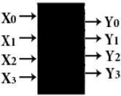
In this logical Walsh-holography, objects, whose logical holograms should be made, are represented in forms of 2^{n}-dimensional vectors. Each component of these vectors corresponds to one of 2^{n} input channels X_{i} of appropriate electric circuits; the same is true for 2^{n} output channels Y_{i}, which are related with components of resulting vectors. The logical holography leads to a new model approach in genetics.
在这个逻辑Walsh全息，物体的逻辑全息应该被表示成2n维向量的形式。这些向量的每一个成员都传达了2n个输入适当的电子线路通道Xi之一；这同样适用于2 n输出通道Yi,与组件的生成的向量。逻辑全息术将导致遗传学的一种新模型方法。

Slide 50
For example, one of applications of classical holography is a technological reproduction of numerous copies of flat templates [Wenyon, 1978]. In this case a special holographic operation is used, which has its analogue in mathematics under the title “convolution of two functions”. For example, if an image of a triangle is convoluted with images of three points, the result is an image of three triangles:
In the logical holography similar reproductions can be made by means of the dyadic convolution of two 2^{n}-dimensional vectors to simulate many cases of different repetitions in genetic sequences (the problem of such repetitions is actual in genetics) [Petoukhov, 2016, http://arxiv.org/abs/1102.3596 ]
例如,古典全息术的应用技术之一的众多平面模板的副本的再生产技术(Wenyon,1978) 在这种情况下,特殊全息操作技术使用,它的数学模拟标题为“两个函数的卷积”。如图，如果一个三角形图形被分成三个部分，那个这个图形最终会是3个三角形。 逻辑全息术中类似的复制品可通过两个2n维向量的二元卷积来模拟，这里有很多种不同的重复基因序列（这种重复的问题是实际遗传学）

Slide 51
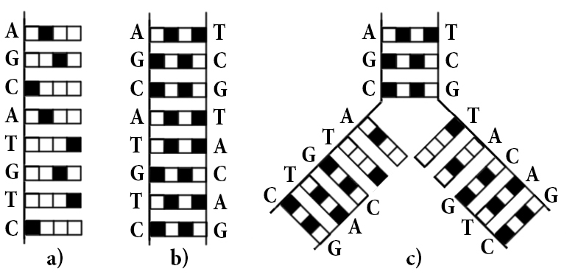
Another example of application of math of the logical holography on dyadic groups of binary numbers is our model of the zipper-like reproduction of DNA (see details in [Petoukhov, 2016, http://arxiv.org/abs/1102.3596 ]):
另外一个关于二元组二进制数的数学逻辑全息术应用的例子，DNA就像拉链模型一样复制。。

Slide 52
此外,沃尔什函数和二元组都是基于“布尔函数的光谱逻辑系统”。它允许创建具有丰富特性的人工智慧数字设备:错误检测和校正;外部环境,适应；培训课程工作,其他数字设备之间的互动等。
为了与geno-logic 编码原则相连接，我们建议使用特殊数学“基因谱逻辑”。根据这一原则,生物体不仅拥有基因编码的蛋白质氨基酸序列,而且还有另外一种编码，它可以转换连锁遗传算法流程， (类比并行存在电脑的软件和硬件)。
In addition, Walsh functions and dyadic groups are the base of so called “spectral logic of systems of Boolean functions”, which allows creating digital devices with rich properties of artificial intellect: a detection and correction of errors; an adaptation to the external environment; a training in a course of work; interactions with other digital devices, etc.
We propose using of special mathematics of the “genetic spectral logic” in biology in connection with our doctrine of the geno-logic code. According to this doctrine, living bodies possess not only the genetic code of protein sequences of amino acids, but also another kind of coding, which allows transferring inherited algorithmic processes along chain of generations (by analogy with a parallel existence of Hardware and Software in computers).

Slide 53
E.Schrodinger (1944) noted: “from all we have learnt about the structure of living matter, we must be prepared to find it working in a manner that cannot be reduced to the ordinary laws of physics… because the construction is different from an anything we have yet tested in the physical laboratory».
For comparison, biological enzymes are millions of times more effective than catalysts in laboratory. What makes the enzyme for 1 second, a conventional catalyst can make only for 200,000 years. We believe that such inherited efficiency of enzymes in biological bodies is defined not only by laws of physics, but also by algebra-logical algorithms of the geno-logic coding, and therefore - in accordance with Schrodinger - this efficiency cannot be reduced to the ordinary laws of physics.
E.Schrodinger (1944)指出：从我们已经了解的生物物质结构,我们必须找到它工作的方式，但这不能减少普通物理定律。因为这里与我们在实验室中已经测试的结构都是不同的。
相比之下，生物酶比实验室里的酶的数百万倍还有效。为什么使用酶产生的作用只能是一秒，但传统的催化剂却可以是20万年呢？我们相信,这种酶在生物体内遗传效率的定义不仅是物理定律,也是geno-logic编码的 algebra-logical算法定律。因此，按照Schrodinger ，这里的有效性不会减少普通的物理定律。

Slide 54
If mankind masters the biological technology of the geno-logic coding for industrial needs, almost all industry will be dramatically improved: medicine, industry of food, industry of building materials,
etc. Let‘s go ahead.
如果人类掌握了关于geno-logic 编码方面生物学知识，并应用于工业化需求，几乎所有的行业都会发生巨大的提升：药物，食品行业，建筑材料行业等等。让我们拭目以非。

Slide 55
Personalized genetics and geno-logic medicine The American journal «Time» in 2008 year has published a list of «the best innovations of the year”. The first place in this list was given to «personalized genetics» from the company «23andMe”. This innovation was recognized much more important then many others, including the Big Androne Collaider from the field of nuclear physics. The company «23andMe» proposes information about genetic perculiarities of persons with a low prise $399 only. The personalized genetics leads to personalized pharmacology, in particular。Now posibilties of personalized genetics are developed intensively in many countries with huge financial supports. But this initial kind of «personalized genetics», which has limited possibilities, uses knowledge about the genetic code of protein sequences of amino acids without knowledge about the geno-logic code.
个性化遗传学和geno-logic药物。美国 《时代》杂志于2008年出版了一系列«年度最佳创新» 该列表的第一位就是«23andMe» 公司的《个性化基因》。.这一创新被认为比其他创新更重要,包括Androne Collaider的核物理领域。公司的提出人类基因的特殊性的信息，仅仅只有$399的奖金。特别是个性化基因导致个性化的药理学但起初«个性化遗传学»有一定的限制,关于蛋白质的氨基酸序列方面却没有geno-logic代码方面的知识。现在基因的个性化发展在很多国家都得到巨大的金融支持。

Slide 56
It is natural to think that the cause of the body‘s genetic predisposition to various diseases is not only violations in amino acid sequences of proteins, but that geno-logic disorders in inheritance of various algorithmic processes also play the important role. We believe that development of knowledge about the geno-logic code will lead to “geno-logic personalized genetics” as a next step in human progress.
可以很自然的想到，导致人体基因倾向于各种疾病并不只有蛋白质的氨基酸序列的错乱，还有基因逻辑紊乱，它在继承各种逻辑算法过程也是有着非常重要的作用。 我们坚信发展geno-logic 编码方面的知识将会引发“geno-logic 个性化遗传学”，这将会是人类有一个大的进步。

Slide 57
In English, initial materials of this presentation exist in Internet for free reading in the book: Petoukhov S., He M. “Symmetrical Analysis Techniques for Genetic Systems and Bioinformatics”, IGI Global, Hershey, USA, 2009, 271 p. -http://www.evernote.com/l/AFnRwSleQRRMI7PGAKFzZgkUEdMP10Lv5J0/ .

Slide 58
THANK YOU FOR YOUR ATTENTION
S.V. Petoukhov Russian Academy of Sciences, Moscow http://petoukhov.com/

